Slide 1
From blame to safety:
Why does language matter in safety planning?
Vickie Crompton, DASV Partnership Manager
Claire Thatcher, lived experience lead

Slide 2
What to expect from the session

Slide 3
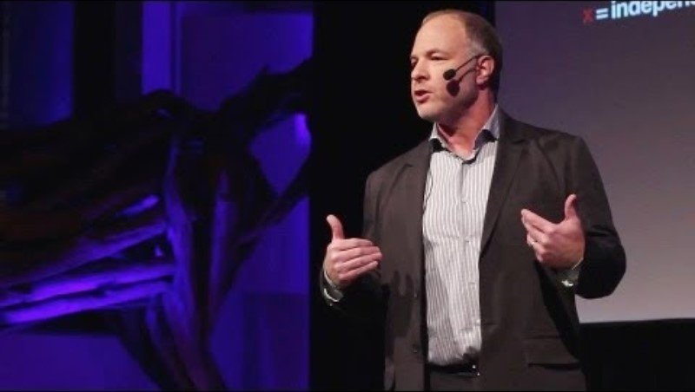
Not about blame
“victim blaming is societal”

Slide 4
Commonly used words & Phrases – thoughts?
- domestic violence
- toxic relationship
- Domestic abuse relationship
- verbal only
- victim
- perpetrator
-child witnessing abuse

Slide 5
Examples
“Failure to protect”
“continues to engage with partner”
“chooses to remain in the relationship”
“Allows him in the house”

Slide 6
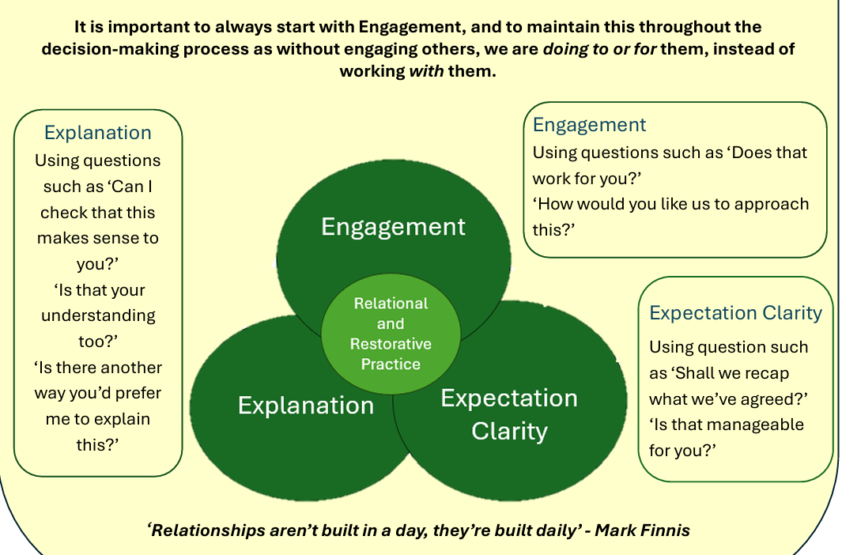
Why words matter – relational practice

Slide 7
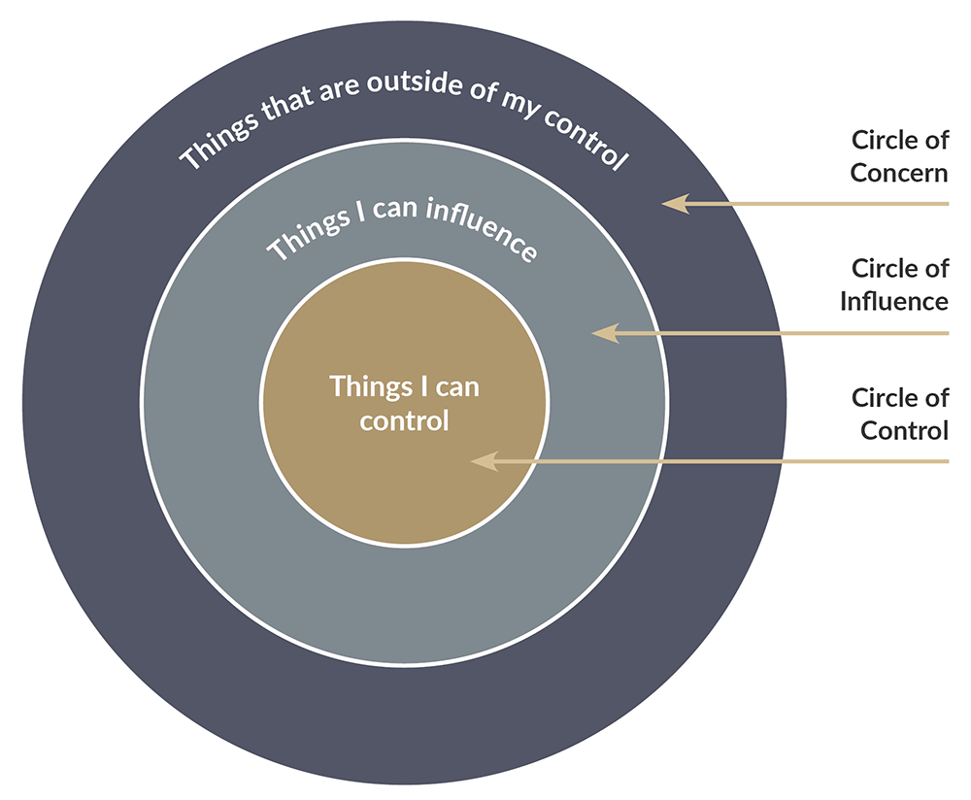
What can be controlled and by who?

Slide 8
exercise
The Professional
The Abusive person
The Person subjected to the abuse

Slide 9
What can you control in your role?
- how you respond to the parent
- creation of safe professional environments
- uphold confidentiality & privacy
- what is shared with the abusive parent
- support with safety planning
- provision of practical help
- supporting a child focus
- supporting emotional regulation
- doing what you promise to do

Slide 10
What protective Parent Can Control
Own parenting
Emotional support
Some safety planning
Notes:
Reinforce strengths-based approach.

Slide 11
What They Cannot Control
Abuser behaviour
Contact situations
System decisions
Notes:
Key message: professionals often overestimate control.

Slide 12
ACTUAL examples from case notes
“Mum has failed to follow the agreed care plan – “No adult arguments or violence in front of the child”
“The client is a serial victim and fails to act on advice given.”
“She doesn’t help herself as she relies on him for money.”

Slide 13
Why does language matter in safety planning?

Slide 14

Relationship window
Working WITH the parent to protect the child as much as legally possible
To
With
Challenge/Expectation
Not
For
Adapted from: Social Discipline Window, Wachtel T & McCold P in Strang H & Braithwaite J (eds), (2001),
Support
Notes:
Part 1- Introduce Relationship Window (5 mins):
This is the main model/theory behind RP.
The vertical axis represents a level of 'challenge/expectation' and the horizontal axis represents a level of 'support.'
Each coloured box shows how we interact with others and how they interact with us, from its own particular combination of challenge/expectation and support.
High Challenge, Low Support- TO
Low Challenge, High Support- FOR
Low Challenge, Low Support- NOT
High Challenge High Support-WITH
So now after this training you’ll be ‘with' 24/7 365?No- we are all human beings and we all have things going on that affect us and ‘with’ is aspirational.
GROUP DISCUSSION- Talk about times when it might be more appropriate to step into the TO or FOR boxes in the short term. (TO-, safeguarding, statutory laws for example. FOR (training, SEN, emotional health, new employee). These can be intentional or not ( TO box is non-negotiables, FOR box is needs and capabilities). Use examples from practice to show that boxes are fluid and we can move between them depending on situation. If time talk about the NOT box and how to avoid this!
NOT box- We need to understand what's going on for people in this box as this is often where we begin our work with families (we might have to do more FOR people to build a trusted relationship). We should be explicit and explain that although we may have to have challenging conversations, we would prefer to work WITH people and how we want to meet their needs whilst empowering them. Often people in the NOT box feel overwhelming feelings of shame and shame needs certain things to grow (secrecy silence and judgement). Therefore we need to do the opposite to start moving towards WITH ( have empathy, lack of judgement, no secrecy and validate experiences).
What things can take you out of the ‘WITH’ box and stops you from being at your best? Which box do you default to when time/caseloads are mounting? What could be putting people in the NOT box? How can we move people out of the NOT box?

Slide 15
reflections?
What will you take into your practice from today?

Slide 16
Please get in touch!
Vickie.Crompton@peterborough.gov.uk
Claire.thatcher@CAMBRIDGESHIRE.gov.uk www.cambsdasv.org.uk

