Slide 1

Parenting with an Abusive Ex
Vickie Crompton & Lydia Mack, Peterborough City Council

Slide 2


Slide 3
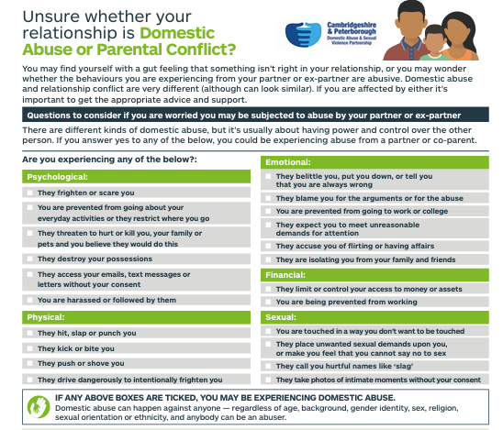

Slide 4

Consultation:
IDVAs
Domestic Abuse Professionals
Social Workers
Child & Family Workers
Lawyers
People with Lived Experience

Slide 5
PROFESSIONAL’S GUIDANCE
Purpose of This Guidance
This guidance gives professionals clear, trauma‑informed, safety‑focused practice advice when working with protective parents who must manage child contact with an abusive ex‑partner. It is designed to complement the parent‑facing guidance and ensure that professionals respond in ways that:
Prioritise the parent and child’s psychological and physical safety
Reduce opportunities for post‑separation abuse
Avoid placing responsibility on the protective parent
Promote child‑centred, structured arrangements

Slide 6
Core Principles for Professional Practice
Child safety and wellbeing come first
Professionals must ensure that their work centres the child’s lived experience, daily routines, emotional needs, and long-term stability above the preferences of either parent.
Recognise post‑separation abuse as ongoing domestic abuse
Separation does not end abuse—monitoring, manipulation, coercion, and litigation misuse commonly continue. Professionals must treat post‑separation behaviours with the same seriousness as in‑relationship abuse.
Avoid assumptions of “co‑parenting”
Co‑parenting requires mutual trust, cooperation, and safety. These conditions are absent in abusive dynamics. Do not encourage co‑parenting when there is a history of abuse.

Slide 7
Parallel parenting is safer and more realistic
Professionals should guide parents toward:
    Structured routine
    Minimal direct contact
    Clear boundaries
    Written communication only
Reduce emotional labour placed on the protective parent
Avoid telling the parent to:
    “Just communicate better”
    “Be more flexible”
    “Meet the other parent halfway”
    “Attend joint meetings”
These directions can unintentionally enable coercive control or re-traumatisation.
Be factual, avoid judgement
Professionals must avoid language implying blame, conflict creation, or mutual responsibility.
Abuse is not “high conflict”; it is perpetration.

Slide 8
Understanding the Protective Parent’s Position
Many protective parents experience:
    Fear about handovers and ongoing contact
    Anxiety when children are away
    Manipulative communication from the ex-partner
    Guilt about maintaining boundaries
    Concern that professionals will misinterpret them as “difficult”
Professionals must validate and normalise these experiences, recognising them as logical responses to an unsafe situation.

Slide 9
How Professionals Can Actively Support Safety
Create safe professional environments
Professionals should:
Offer separate appointments to avoid joint meetings
Ensure the abusive parent is not present unexpectedly
Use different waiting rooms or staggered arrival times
Disable speakerphone in all calls
Uphold confidentiality and privacy
Protective parents may be tracked through:
Children’s phones
Shared apps
Location sharing
Professionals should:
Communicate safely
Avoid sharing addresses or schedules
Ask the parent about technological risks
Promote safe, structured handovers
Encourage:
School as neutral handover location
Third‑party or contact centre arrangements
Written instructions only
Avoid any professional expectation that a victim should supervise contact

Slide 10
Supporting the Parent to Stay Child‑Focused and Emotionally Grounded
Professionals can help the parent by reinforcing:
Focus on what the parent can control
Their home routines
Their communication style
Their boundaries
Their child’s transition rituals
Encourage “business‑like” communication
Short, factual responses
No emotional engagement
Use of email or parenting apps
Avoid direct confrontation
Support them to manage emotional impact
Professionals can guide the parent to:
Normalise anxiety when children are away
Avoid rumination
Plan calming routines
Draw on support networks
Encourage boundaries around what children share
Children must not gather information
Children shouldn’t keep secrets
Encourage parents to remain neutral, calm, and validating

Slide 11
What Professionals Should Not Do
Professionals must avoid:
Encouraging joint meetings or mediation unless safe (shuttle only)
Pressuring the parent to accommodate the abusive partner’s requests
Suggesting flexibility that undermines the safety plan
Criticising protective strategies such as strict routines
Assuming the parent is “uncooperative” when they decline unsafe actions

Slide 12
Professional Responsibilities Around
Contact Arrangements
Ensure understanding of Parental Responsibility and legal orders
Professionals should:
Know who has PR
Know whether there are Child Arrangements Orders, Prohibited Steps Orders, or NMOs
Record and store these documents
Support the parent to develop a safe parallel‑parenting plan
Plans should be:
Specific
Predictable
Unambiguous
Future‑proof
Avoid vague terms like “reasonable contact”.

Slide 13
Evidence‑Informed Practice to Support the Parent’s Concerns
Professionals should help parents to:
Keep factual logs
Record children’s behaviours before/after contact
Save messages
Photograph visible injuries
Note school or professional observations
Professionals must avoid encouraging leading questions to children

Slide 14
Multi‑Agency Working
Professionals should ensure:
All agencies receive relevant information
Schools know collection permissions
Settings are aware of risks
Communication pathways are safe and consistent
Do not assume another agency is managing the risk—confirm directly.

Slide 15
Supporting the Parent Through Their Own Emotional Journey
Professionals can:
Normalise feelings of injustice, fear, frustration
Reinforce that abuse was not their fault
Encourage self-care rituals when children are away
Help the parent identify supportive people
Signpost specialist domestic abuse services

Slide 16
Key Safety Messages for Professionals to Reinforce
“You cannot change your ex-partner; you can change how you respond.”
“Your child needs you calm, predictable and regulated.”
“Boundaries are not punitive—they keep you and your child safe.”
“Being ‘the better person’ means modelling emotional safety, not perfection.”

Slide 17
Professional Tools & Resources
Professionals should routinely signpost to:
Local domestic abuse services
National helplines
Child maintenance support
Parenting apps that secure communication
Legal advice routes
Mental health and wellbeing support

Slide 18
Next Steps
6 Week Group Work Programme in Peterborough developed
2 Groups funded to run
Train the Trainer for Groupwork will fund future groups
3,000 copies of parent’s guide printed
Professional’s guidance printed
Both available online
Professional’s training available in Peterborough – Cambs to follow
Questions – please contact
Vickie.Crompton@peterborough.gov.uk
Lydia.Mack@peterborough.gov.uk

