Slide 1

Coproduction in the field of DASV

Slide 2
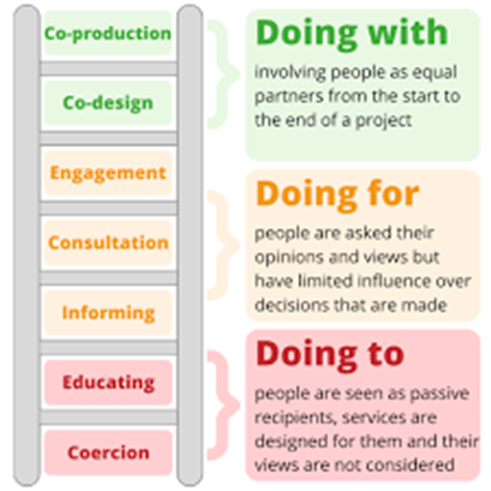
What is Coproduction
Coproduction is where people with lived experience and professionals share power, decision‑making, and responsibility to design, deliver, and evaluate services together.
Rather than doing things to people or for people, coproduction means doing things with people, valuing everyone’s knowledge equally. It’s built on principles of trust, mutual respect, openness, and collaboration, ensuring that services are shaped by the people who understand their impact firsthand.
At its heart, coproduction aims to create more effective, equitable, and meaningful outcomes by bringing together different perspectives, skills, and experiences to solve problems collectively.

Slide 3
Why use Coproduction in the field of Domestic Abuse and Sexual Violence (DASV)
Between 1st April 2024 until 31st March 2025, Cambridgeshire Constabulary received….
13,861 reports of domestic abuse
2,033 reports of serious sex offences
However, research shows that only 1 in 5 people will report when they are the victim of DASV. Based on this, a more accurate reflection of the levels of DASV across Peterborough and Cambridgeshire is:
69,305 estimated incidents of Domestic Abuse
10,165 estimated incidents of serious sex offences

Slide 4

What is the ask….
If you have firsthand experience of DASV, whether you have reported this or not, we really want to hear from you, learn from you, and work alongside you to understand what is working, what is not working, or what is missing so that we can work together to coproduce services and systems that work for the people who need them, when they need them.
Cambridgeshire County Council DASV Partnership - Survivor Voice / Co-Production

Slide 5
What we did at the first Coproduction Forum
We held the first Peterborough DASV Coproduction Forum for women only on 5th March 2026. At the forum, all attendees were asked to complete a ‘5 finger reflection exercise…
Thumb – One thing that someone found helpful or positive which they would give a thumbs up to.
Index finger – One idea that could improve the support available.
Middle finger – One thing that wasn’t helpful or resulted in a negative experience.
Ring Finger – One thing that is treasured for each person.
Little Finger – One pinkie promise of something nice to do for self.

Slide 6
What did people give a thumbs up to?
Community based programs - the Freedom Program and Own My Life (so long as it is delivered at the right time for each person), Buried in treasures support group.
Counselling – helping me to understand I am not weak and the psychology of coercive control
Community services – Peterborough Women’s Aid, Living Keys, Annes House.
Trusted people – My lovely GP, my daughter gives me strength, friends – my friend helped me manage contact with the police and gave me somewhere safe to go, the community, my IDVA, school staff, DWP worker and family.

Slide 7
Ideas shared for improving people’s experience
Collaboration between professionals – Only having to explain to one person what happened and professionals working together to support as one.
Choices and time – Let me know what choices I have and give me time to think.
Clarity – Understanding what services do and don’t do.
Communication – Neurodiverse diagnoses should be considered both from professionals offering support and in the way that information is shared (clear, simple language).
Regular updates – a single point of contact who can provide me with regular updates.
Being heard - Police, CPS, Court system, professionals to attend forums so that we can explain the impact of fear/lack of accountability when criminal justice system supports the perp and undermines the survivor.

Slide 8
What wasn’t helpful?
The legal process – Police are sympathetic but traumatising. Evidential burdens are too high or not submitted in time to be admissible, the length of court processes and delays never being explained, justified or apologised for.
Family Court Process – Lack of legal aid which results in people having to be litigants in person and sitting in the same room as perpetrator. Information is shared without consent.
Children’s Social Care –.Forced to attend conferences and meetings with the perpetrator in the same room. If become upset, then seen as emotionally unstable.
Language Barriers – cause more delay and difficulty. Sometimes it can take months for court letters or orders to be translated.
Lack of choice – I was not asked if I was okay speaking with a male police officer alone. I wasn’t given a choice whether I would feel safer working with a woman rather than a man.

Slide 9
What did people treasure?
Time – Time to process information. Time to decide. Time to explain and be heard.
Validation – Being believed. Being Listened too. Being understood.
Not being alone –.Someone coming with me to my new home, my daughter's new school, my new GP, and my housing assessment. Being told; ‘we are here beside you’.
Children – My children being offered their own support.
Connection – Meeting others who understand what I have gone through.
Safety – Having a safe and calm living space.
Kindness – A hug.

Slide 10
Promises people were able to make to themselves
Resting without guilt
Being true to myself
Learning to respect and love myself.
Be kinder to myself and criticise myself less
Stop blaming myself or questioning if it was my fault
Be there for my children’s future.
Give myself permission to be me.
Travel at least 3 times a year.
Say a prayer for myself. I am expected to do a lot for others, but nobody can stop me saying a prayer for myself.

Slide 11

For your information…
The Cambridgeshire & Peterborough website contains details of all DASV services in the local area, national helplines for anyone experiencing DASV and useful resources for professionals.
http://www.cambsdasv.org.uk/
Changing Futures facilitate Coproduction for people experiencing multiple disadvantage across Peterborough and Cambridgeshire.
https://cambridgeshireinsight.org.uk/changing-futures-cp/

