Slide 1

Our mission and values
To provide a specialist response to domestic abuse and violence against women and girls; empower victims to be in control of their own future and create everlasting change.
Partnership We will work in partnership with statutory agencies, charities, community groups and sister organisations to achieve our mission.
Passion We will work with passion to support victims of gender-based violence.
Empowerment We will empower victims to take back control of their lives.
Impartiality We will work in a non-judgemental and non-discriminatory way where everyone is welcomed and valued.
Peterborough We will provide specialist services tailored to the needs of the Peterborough community and surrounding areas.

Slide 2


The Peacock Project

Slide 3
Support
Safety Planning
Risk Assessment
Emotional support
Court advocacy
Counselling
Support with
  Accommodation
  Refuge
  Debt
  Benefits

Slide 4


Group work
Freedom Programme
Own My Life

Slide 5


Empowerment
Self Esteem
Confidence
Reduce Isolation
Peer Support

Slide 6
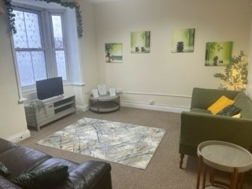
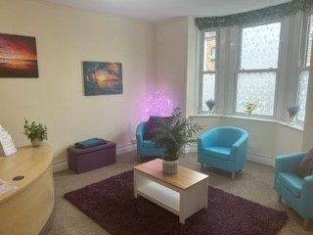
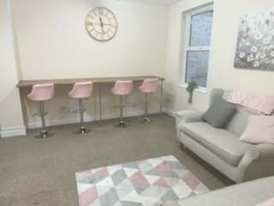
Anne’s House

Slide 7

Supporting Victims from the South Asian Community
Research from ARU
3 frontline workers, 1 community manager
2 years of funding
Steering group
Specialist training
Awareness raising
Being led by the Community

Slide 8


Lithuanian Community Work
Same language
Offer outreach support
Awareness raising

Slide 9

Referrals
Email Referrals referrals@wa-support.co.uk
Telephone 01733 894964
Website

Slide 10

Social Media

