Slide 1
Family Law Courts and Survivors of Domestic Abuse
April 2023
Simon Kerss
Honorary Fellow, Policing Institute for the Eastern Region (PIER) / Independent Domestic Homicide Review Author / Home Office DHR Reader
Email: simon.kerss@aru.ac.uk or simon.kerssconsultancy@gmail.com

Slide 2
Biography
Simon is a Visiting Research Fellow with the Policing Institute for the Eastern Region (PIER) where he specialises in evaluating agency responses to VAWG and other forms of Serious Violence. He is also an Independent Domestic Homicide Review (DHR) Author, Home Office-appointed DHR Reader and VKPP Peer-Review Cadre Member
Previously, Simon was a Lecturer in Criminology at Anglia Ruskin University, Cambridge. Prior to this, he was the Domestic Abuse and Sexual Violence Partnership Manager for Cambridgeshire and Peterborough for 10 years.
Simon also worked from 1997 - 2007 in a variety of roles across Children’s Services in Suffolk and Cambridgeshire.

Slide 3
Outline
Context to domestic abuse survivor interactions with the Family Law Courts
Issues with domestic abuse survivor interactions with the Family Law Courts
Explanations for issues with domestic abuse survivor interactions with the Family Law Court
Steps to address these issues

Slide 4
Context to domestic abuse survivor interactions with the Family Law Courts
Five key areas of interaction between domestic abuse survivors and the Family Law Court:
  Non-Molestation Orders (Domestic Violence Remedy)
  Residency Orders (Domestic Violence Remedy)
  Children Act (Private Law Cases)
  Divorce
  Forced Marriage Protection Orders and Female Genital Mutilation Protection Orders

Slide 5
Context to domestic abuse survivor interactions with the Family Law Courts
c. 32,000 Domestic Violence Remedy Orders per annum (84% Non-Molestation Orders, 16% Residency Orders)
c. 55,000 Children Act (Private Law cases) per annum
c. 110,000 Divorce cases per annum
c. 400 Forced Marriage Protection Orders and Female Genital Mutilation Protection Orders per annum (HM Government, 2022)

Slide 6
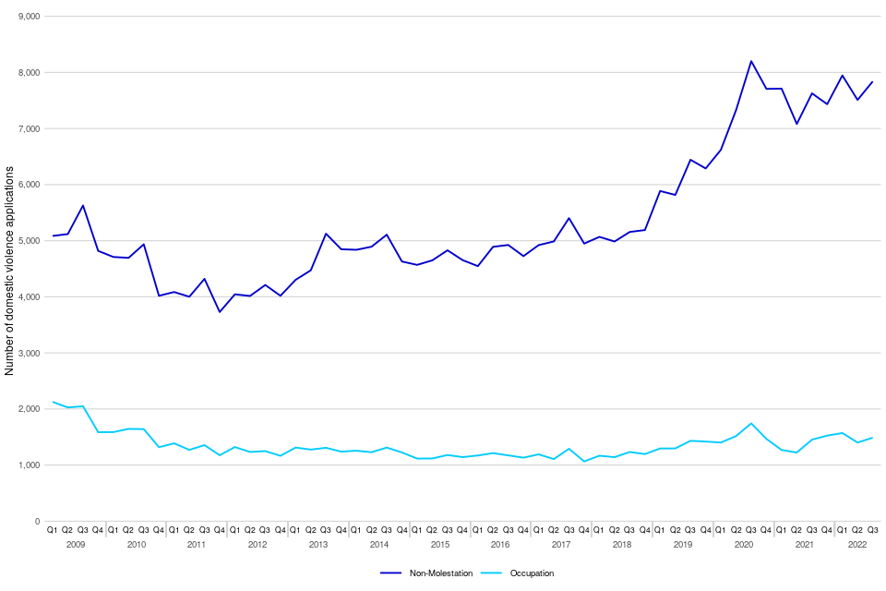
Context to domestic abuse survivor interactions with the Family Law Courts
Consecutive national ‘End Violence Against Women and Girls’ strategies have prioritised ‘civil remedies’ as a resolution to domestic abuse

Slide 7
Context to domestic abuse survivor interactions with the Family Law Courts
Cambridgeshire Family Courts research (Kerss, 2021) based on ex-parte Non-Molestation Order applications
Demographics:
  88% female applicants (aged 17 – 60)
  85% male respondents (aged 22 – 61)
  77% applications involved children

Slide 8
Context to domestic abuse survivor interactions with the Family Law Courts
Risk factors:
  100% of applications cited verbal abuse, stalking and harassment, and escalation of abuse over time
  96% cited coercive control and physical violence
  42% cited the presence of financial abuse and ongoing issues with shared accommodation/housing
  38% of the applications, threats to kill were cited, and 35% the applicant had stated that the respondent had threatened suicide
  19% of applications cited the use of sexual violence, 8% cited the abuse of animals. In a further 8%, applicants stated that the respondents had previously breached court orders or police bail conditions

Slide 9
Issues with domestic abuse survivor interactions with the Family Law Courts
Ministry of Justice (2020) found “that deep-seated and systematic issues…were found to affect how risk to both children and adults is identified and managed”.
Three main barriers:
  1. “The pro-contact culture of the courts and professionals involved in child arrangement cases; submissions highlighted a resulting lack of understanding of the different forms that domestic abuse takes, and of the ongoing impacts of abuse on children and victim parents, the systematic minimisation or disbelief of abuse, and the acceptance of counter-allegations without robust scrutiny”.

Slide 10
Issues with domestic abuse survivor interactions with the Family Law Courts
2. “Evidencing abuse; victims reported difficulties evidencing abuse, particularly where there was a focus on single incidents or recent physical abuse, and where they encountered stereotypical views of how an ‘ideal victim’ should behave”.
3. “Silo working can result in evidence of abuse accepted in one system, for example the criminal courts, not being acknowledged or effectively engaged with in the family court”.

Slide 11
Issues with domestic abuse survivor interactions with the Family Law Courts
“Legal processes provide an opportunity for perpetrators to continue and even expand their repertoire of coercive and controlling behaviours post-separation” (Douglas, 2017)
“We are seeing the courts being used increasingly for frivolous matters and it does to some extent seem that the courts are increasingly being used as a continuation of abuse for survivors of domestic and child abuse” (Kaspiew et al., 2015)

Slide 12
Explanations for issues with domestic abuse survivor interactions with the Family Law Court
Absence of support and empathy
Lack of understanding the lived experience of domestic abuse
Communication and language used (SafeLives, 2022)

Slide 13
The ‘Three Planets’ Model
Hester 2011
Domestic Abuse:
(criminal law);
range of support
violent male partner
Family Law:
(private and civil law);
negotiated or
mediated outcome;
good enough
father
Child Protection:
(public law)
welfare approach;
state intervention
in abusive families;
mother seen as
failing to protect

Slide 14
Steps to address issues
Pilot launched at family courts in North Wales and Dorset to better support victims of domestic abuse
Sets out to improve information sharing so that victims avoid retelling traumatic experiences
Part of government’s decisive action to tackle domestic violence and improve victim support (HM Government, 2022)

Slide 15
Steps to address issues
Agencies will first gather information and assess whether there are any concerns for a child or person involved in the case about substance misuse, domestic abuse, or other welfare issues
There will then be a hearing to decide what interventions or decisions are required, for example whether it could be suitable for mediation out of court
The new process aims to take the confrontational elements out of the family court system, with a focus more on investigating and solving problems to reduce potential harm to those involved (HM Government, 2022)

Slide 16
Conclusions
Family Law Court interventions are supposed to provide a range of civil remedies to address domestic abuse
However, research shows that such interventions can lead to increased risk and harm for applicants
Issues with survivor interactions with the Family Law Courts have been recognised at a national level
None-the-less, survivors require ongoing support from practitioners, friends and family to navigate the Family Law processes

Slide 17
Any questions?

