Slide 1
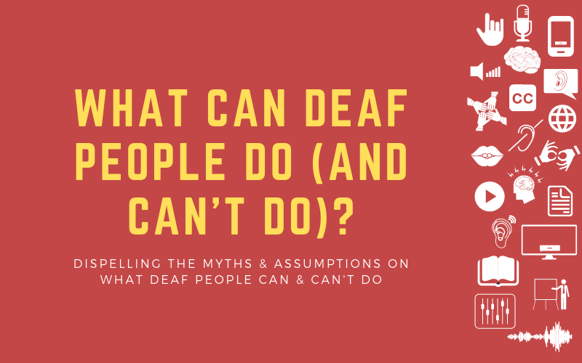

Cambridgeshire Deaf Association
IDVA Service for Deaf people
Rachael Dance
Registered Sign Language Interpreter
Deafblind Advocate & Interpreter
Deaf Advocate
Independent Deaf Domestic Violence Advisor

Slide 2


1 in 6 people across the UK are affected by some level of Deafness
This equates to 11million people
Almost 5 million of these people are of working age
2/3 of people feel isolated at work due to not being able to hear.
2 Million people in the UK are hearing aid users
Roughly 151,000 people in the UK use British Sign Language
Not including Interpreters, translators etc.
Notes:
1 in 6 people in the UK have some level of Deafness
Types of Deafness – Hearing gone deaf or born Deaf. Deaf from birth = Sign language usually or some form of device. Hearing and gone deaf means hearing aids possible and more speech and relying on English

Slide 3
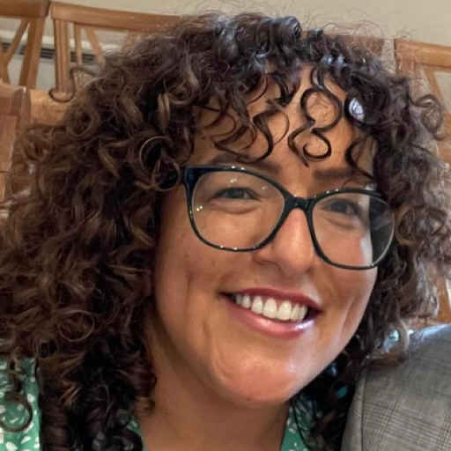
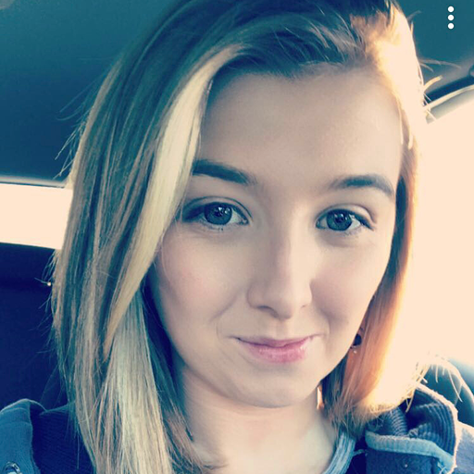
Our Service and Team
Rachael
Service Manager
Qualified IDVA
Qualified Advocate (Care Act)
Qualified IDVA
Freedom Program Facilitator
Emma
Native BSL User, Profoundly Deaf
Training Advocate
Qualified IDVA
Notes:
We have a team of Advocates who support people with a variety of other issues including Care reviews, assessments, Police, Court processes, benefit appeals and applications, financial difficulties and housing. The connection we have with the Deaf community means that self-referrals are most common with our service.
We run the freedom course and soon Emma will be involved in that too. CDA worked closely with Misbah previously at Women’s Aid to ensure the course stuck to the original course material as much as possible. We run this in a very visual way and many women that have been on the course have made close friendships with other attendees, been able to share their story for the first time and many have gone on to leave the relationships after the course. We offer safety planning and 1:1 discussions throughout the course and ensure that the women are supported to remain safe.
Support Deaf, profound, BSL and hearing loss (age related hearing loss)

Slide 4
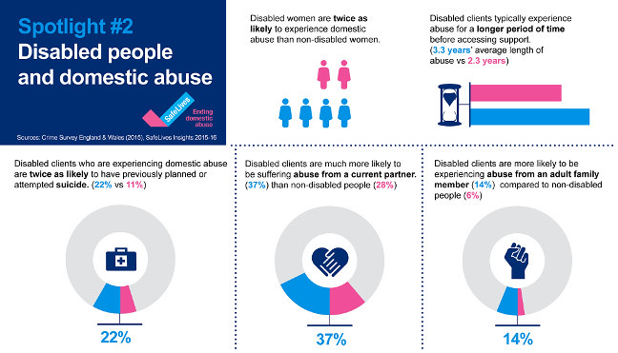
Notes:
Some statistics to show how prevalent domestic abuse is in the deaf community. The Deaf community experience a much higher rate of mental health issues and of domestic abuse. Support is harder to access and can take much longer for people to reach out because of the additional barriers, wait length for interpreters can be up to 3 weeks at the moment. Imagine someone on the cusp of leaving or reporting abuse and about to make that decision, only to be told, they can be heard in 3 weeks time by police, IDVA or Social Care.
Our service was set up because we feel this isn’t a good enough provision for Deaf people. The Deaf community can contact us in BSL, using speech to text or can contact staff who are experienced at supporting people with hearing loss and get a response within 24 hours.
We are really keen to have referrals from the IDVA team and any other teams quickly so that we can start to close the gap between the wait times that hearing people experience and the wait time that Deaf people experience.
We also run the freedom course will talk more about this later.

Slide 5
“Deaf women are at twice the risk of being abused and getting support is 4 times more difficult. ”
“He’s my husband so I have to have sex with him…”
“It’s not really rape, just forced me to have sex with him”
“They won’t let you keep the kids if I leave
Because you’re Deaf.”
“My parents have all my PIP, It’s for them to look after me.
They told me I couldn’t manage it because I’m Deaf.”
“My Family really liked him.
They told me I wouldn’t find another hearing man
who would put up with my Deafness"
“I had no one to turn to.
He told everyone my signing wasn’t good enough so he communicated for me.
I can’t call the police and didn’t have any support. I had to stay.”
“She’s looking after me because she told me I can’t work because I’m Deaf…”
https://safelives.org.uk/knowledge-hub/spotlights/spotlight-2-disabled-people-and-domestic-abuse
https://signhealth.org.uk/for-professionals/domestic-abuse-service/

Slide 6
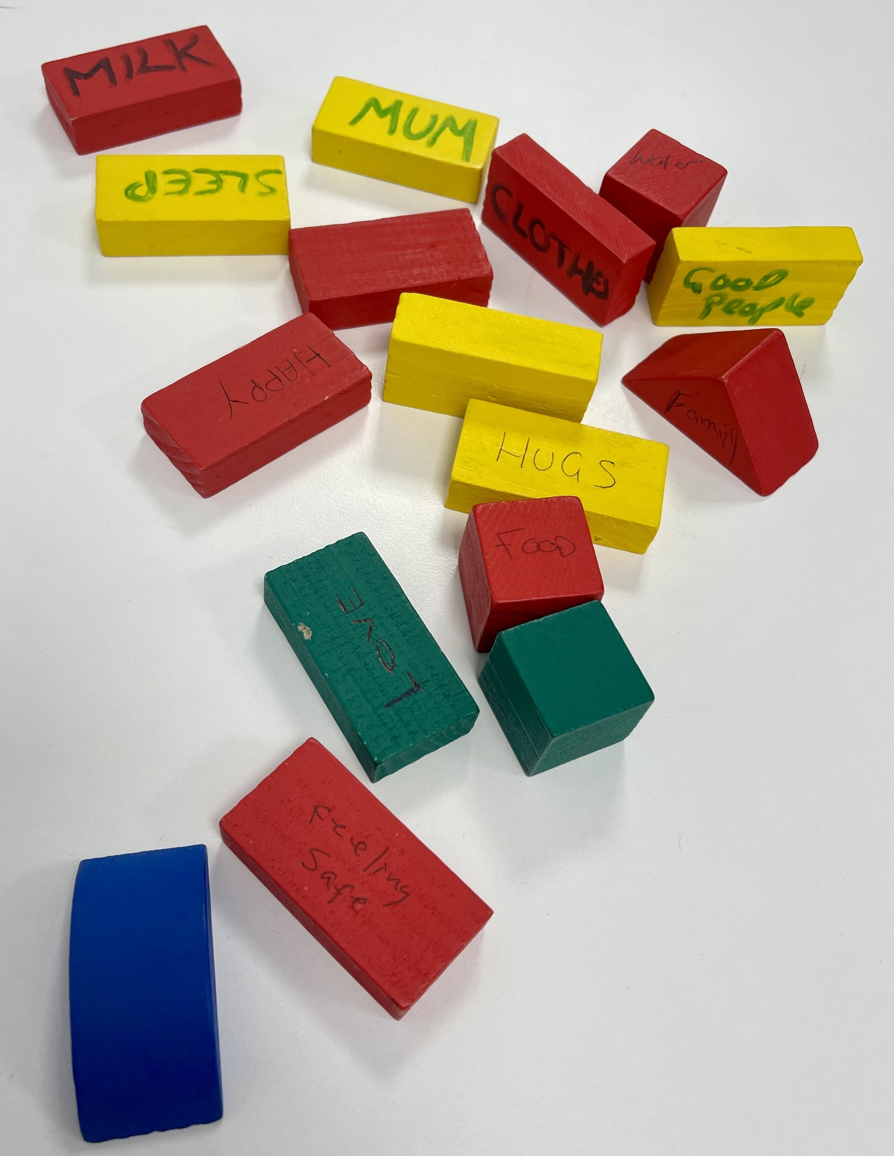
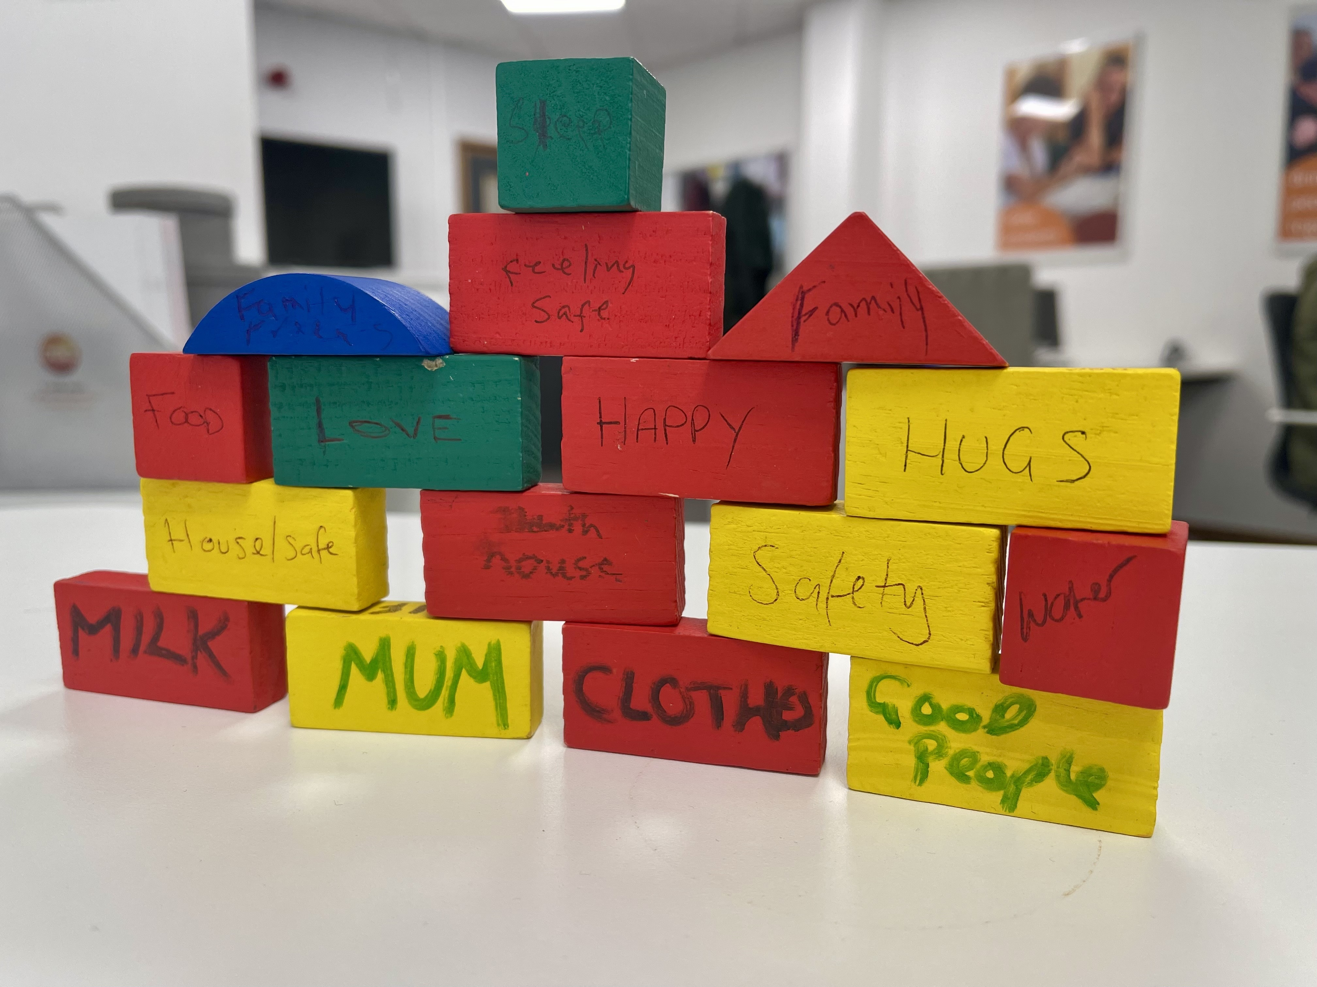
Freedom Course:

Slide 7
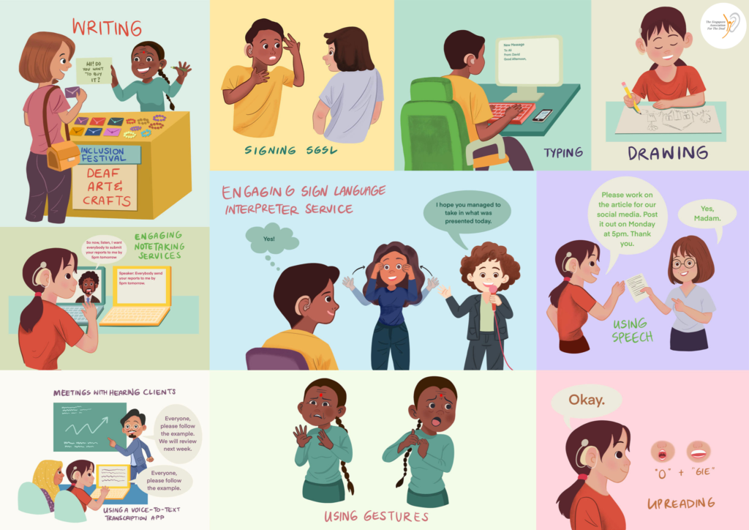

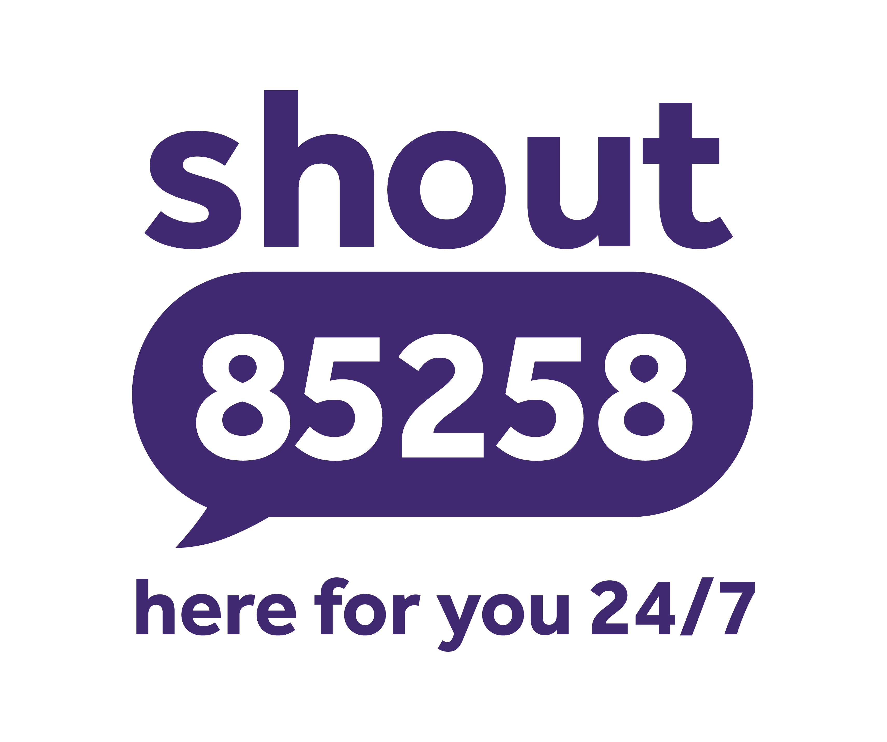
What Can Professionals Do?
Book a BSL Interpreter or Speech to Text reporter
(Know how to book them before you need to)
Use Basic English to communicate things urgently. Not vital information. – Miscommunication
Consider barriers – EG: Screens/layouts in court,
Refer to relevant services: CDA IDVA service, SHOUT, Sigh Health Psychological therapies etc.
Notes:
Booking Interpreter: You’re relevant agency? The Big Word.
How much notice do you need to book a BSL Interpreter?
How many Deaf, BSL users are in UK? Around 151,000
How Many BSL Interpreters do you think there are in UK? 754 (Roughly 201 Deaf people per Interpreter)
Be patient – Explain some jargon or some process that may have been misunderstood. Example: Solicitor writes on paper “I had enough information”
Deaf woman+ Mental Health reads “Had enough” and went mad.
Get an Advocate or IDVA in to support. Example of couple who had 24hours without communication. BSL is vital even if waiting for interpreter service, we can support to give conversation, emotional support and practical options. This helps to reduce stress, anxiety, depression and isolation.
We can attend police stations, Interviews, witness statements, home visits, SARC and any other place. Similar to appropriate adult but can support long term like IDVA even in non-DV cases.

Slide 8
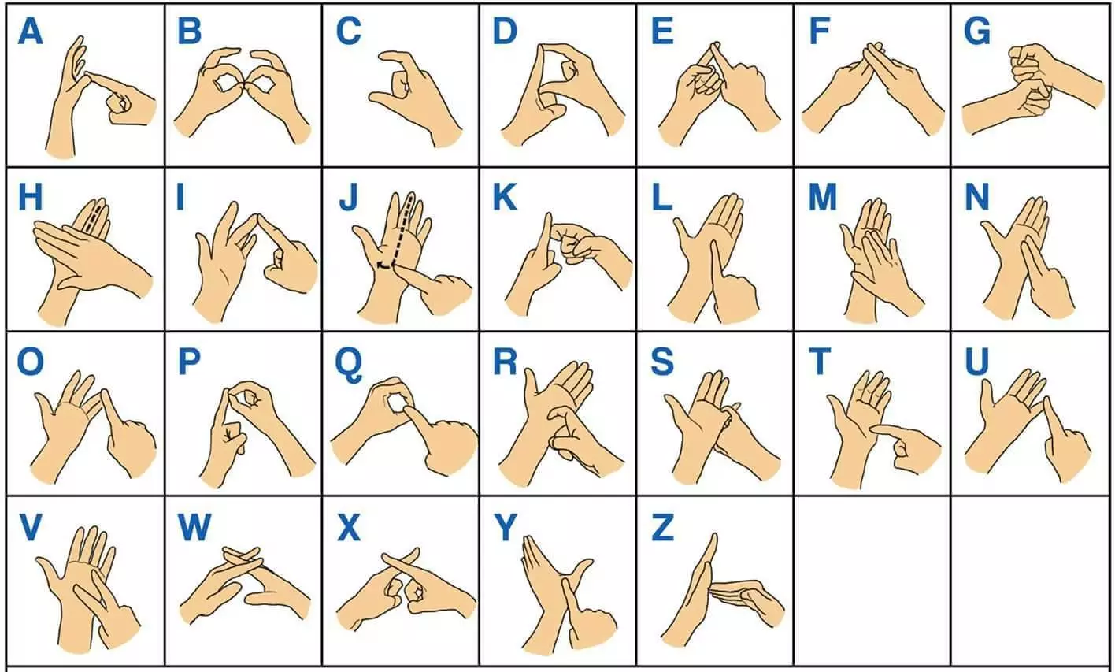

Slide 9
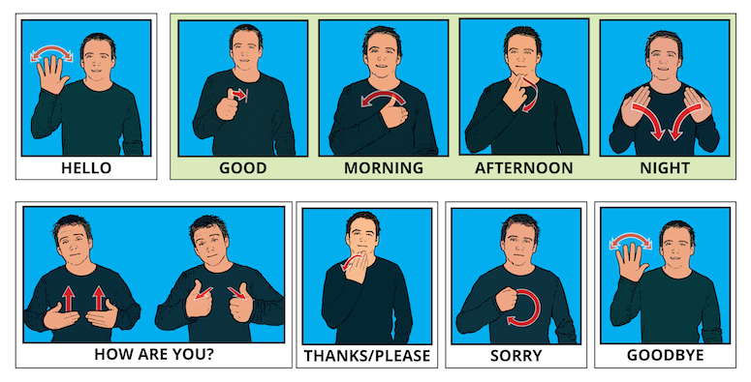
Notes:
Apologies in advance because the pictures used to show how signs go, are always very odd! Don’t know why they can’t make a normal looking person do it :D

Slide 10
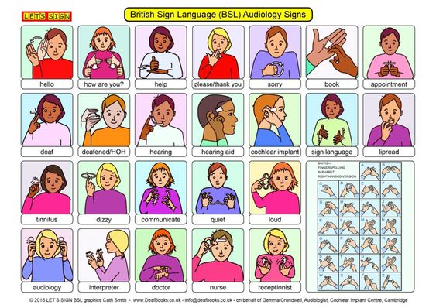

Slide 11
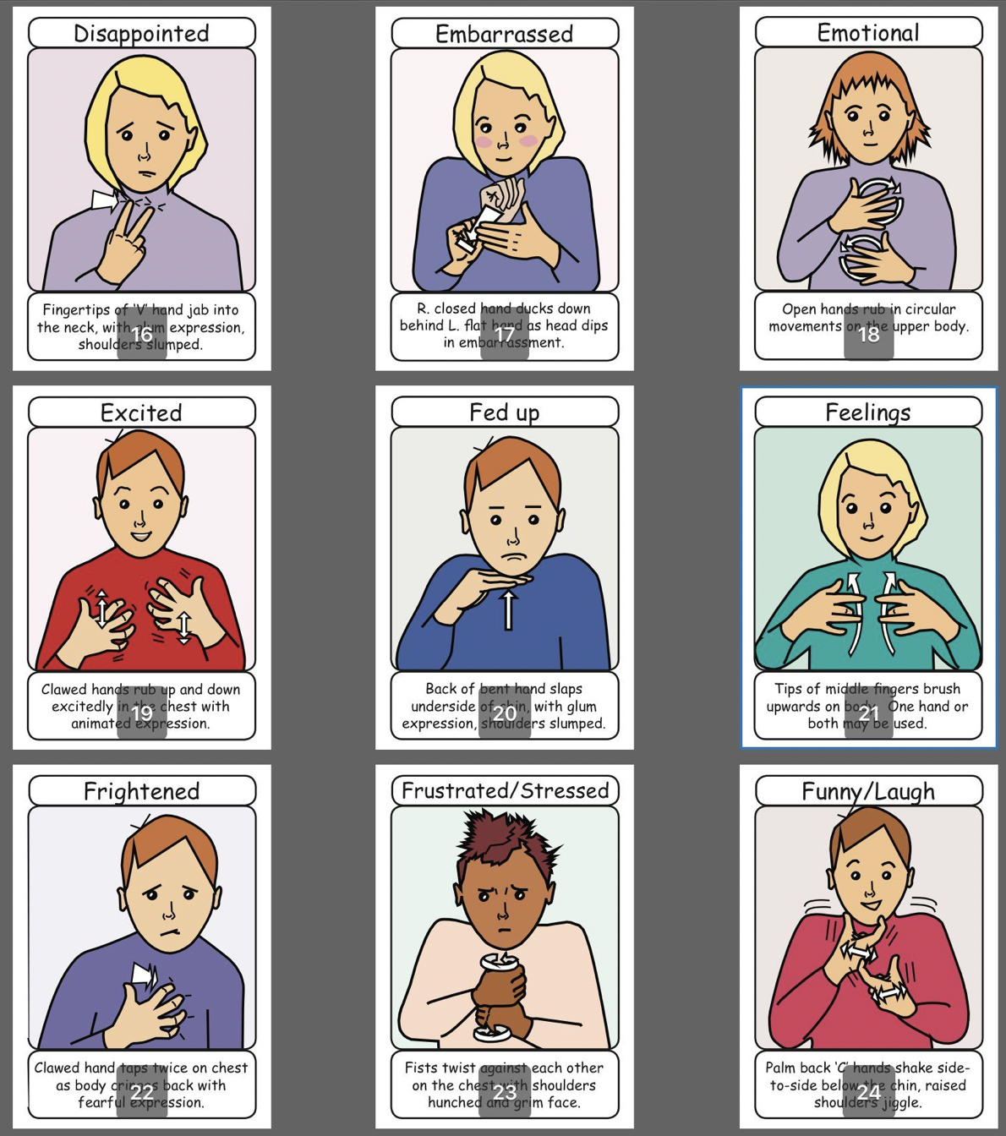
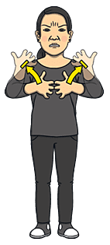
Angry

Slide 12

Any Questions?

Slide 13
Contact Details/ Referrals:
Rachael.dance@cambsdeaf.org
www.cambsdeaf.org > Get Support > Advocacy & Casework
(Contact Line – Domestic abuse support or Advocacy meeting)
07387 266153 (My direct number)
07429 231230 (Duty Text Number)

