Slide 1
Understanding Adult Family Violence
Cambridgeshire Domestic Abuse Champions Network
April 2024
Simon Kerss
Honorary Fellow (PIER)
Independent Domestic Homicide Review Author

Slide 2
Background
To date, the majority of research and policy to tackle domestic abuse has focussed on the issue of Intimate Partner Violence (IPV)
However, emerging research, improved datasets and learning from DHRs suggest that issues associated with Adult Family Violence (AFV – domestic abuse perpetrated by a family member over the age of 16) require our attention as practitioners

Slide 3
Definition (current cross-Governmental)
The definition of domestic violence and abuse is:
  Any incident or pattern of incidents of controlling, coercive or threatening behaviour, violence or abuse between those aged 16 or over who are or have been intimate partners or family members regardless of gender or sexuality. This can encompass but is not limited to the following types of abuse: • psychological • physical • sexual • financial • emotional.
  Controlling behaviour is a range of acts designed to make a person subordinate and/or dependent by isolating them from sources of support, exploiting their resources and capacities for personal gain, depriving them of the means needed for independence, resistance and escape and regulating their everyday behaviour.
  Coercive behaviour is an act or a pattern of acts of assault, threats, humiliation and intimidation or other abuse that is used to harm, punish, or frighten their victim.

Slide 4
Problems with the definition
“Obscures at best, and denies at worst, a gendered analysis of male violence against women
Downgrades forms of violence disproportionately experienced by minority women
Assumes that the dynamics in intimate partner violence (IPV) are the same as those of violence by family members (e.g. between siblings, between parents and children)
The inclusion of ‘incident’ or ‘pattern’ continues to obscure the reality of intimate partner violence
Continues to marginalise rape and sexual violence
The list of forms of violence and abuse is vague and arguably out-dated.” Kelly and Westmorland (2015)
Also, Loseke (2005), Collins (2008), Ray (2011), & HMIC (2014)

Slide 5
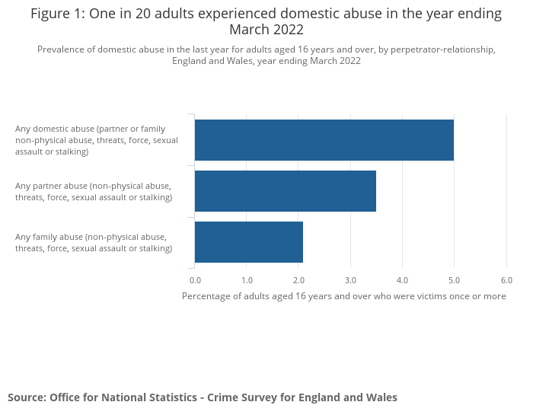
Prevalence

Slide 6
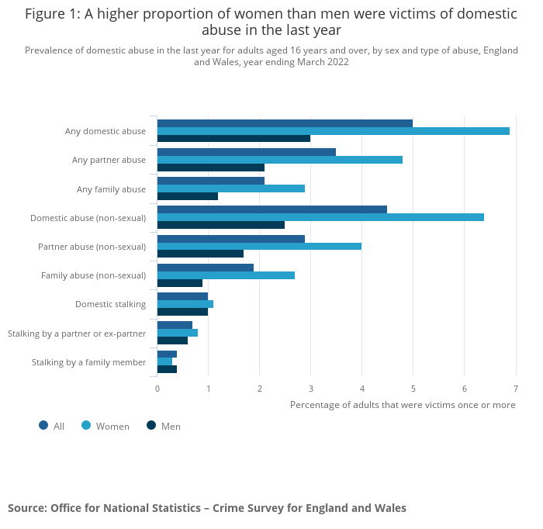
Prevalence

Slide 7
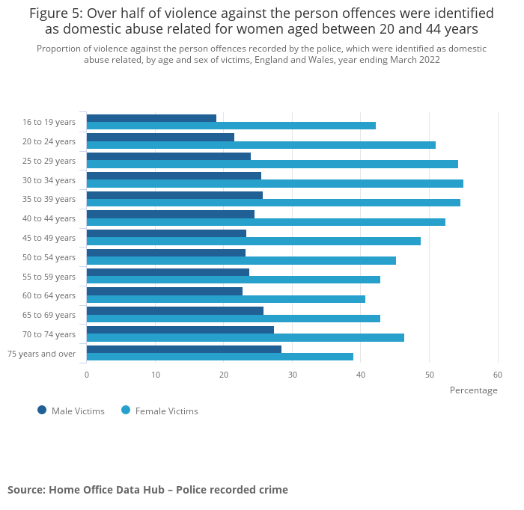
Prevalence

Slide 8
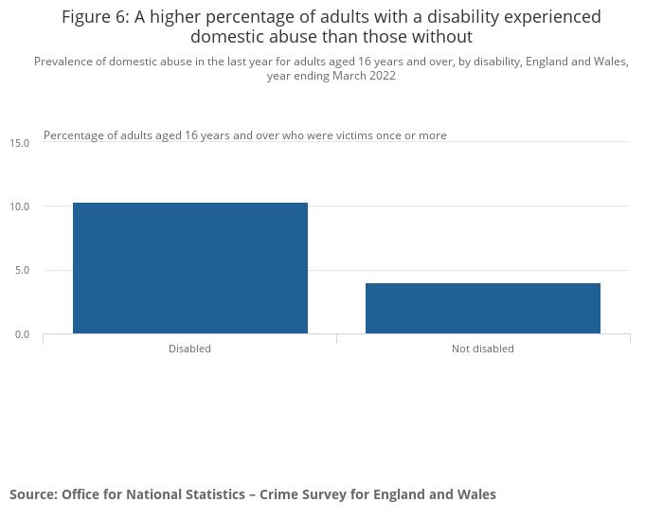
Prevalence

Slide 9
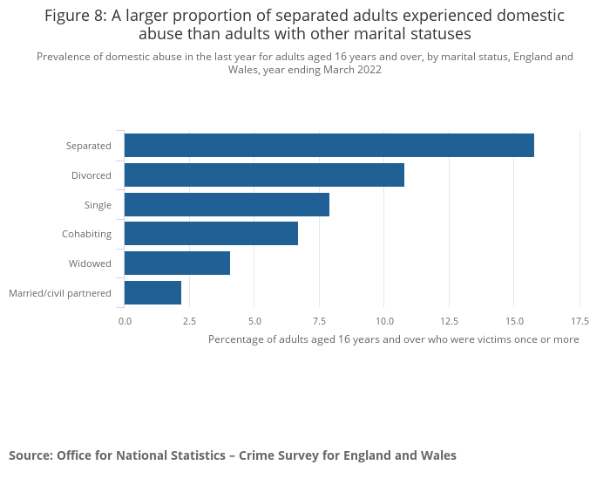
Prevalence

Slide 10
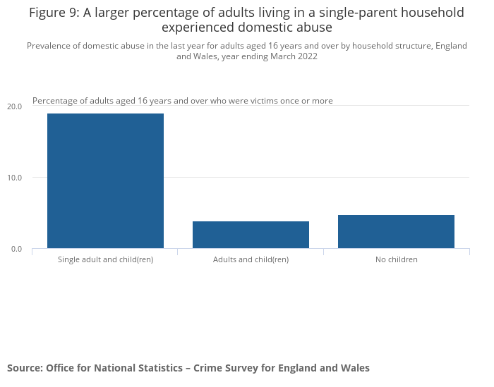
Prevalence

Slide 11
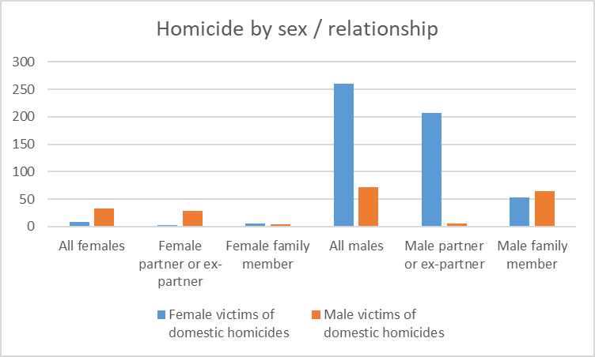
Prevalence
Homicide Index data for the year ending March 2019 to the year ending March 2021 show that 72.1% of victims of domestic homicide were female.
Of the 269 female domestic homicide victims, the suspect was male in the majority of cases (260). In the majority (77.0%) of female domestic homicides the suspect was a male partner or ex-partner, whereas in the majority (62.5%) of male domestic homicides, the suspect was a male family member.

Slide 12
Prevalence (VKPP)

Slide 13
Prevalence (VKPP)

Slide 14
Risk Factors Associated with AFV
Age (e.g. Home Office, 2016 & 2018 & Sharp-Jeffs & Kelly, 2016 )
Ethnicity (e.g. Home Office, 2018 & Safe Lives, 2017)
Gender (e.g. Home Office, 2018, Bows, 2018 & WHO, 2013)
Relationship type (e.g. Sharp-Jeffs & Kelly, 2016 & Bourget, et al., 2007)
Disability / illness (e.g. Home Office, 2018 & Safe Lives, 2017)
Previous history of violence / criminality (e.g. Sharp-Jeffs & Kelly, 2016 & Gadd, et al., 2014)
Substance misuse (e.g. Home Office, 2016 & Sharp-Jeffs & Kelly, 2016)
Mental health (e.g. Home Office, 2016 & Sharp-Jeffs & Kelly, 2016)
Risk assessment tools and processes (e.g. Home Office, 2016; Sharp-Jeffs & Kelly, 2016 & HMIC, 2014)
Low awareness (public and practitioners, e.g. Bows, 2018; Home Office, 2016 & Sharp-Jeffs & Kelly, 2016)

Slide 15
Risk Factors Associated with AFV
1. The intensity of time spent together
2. The intensity of (involuntary) commitment to each other
3. The nature of family interactions (often conflict-structured)
4. The different social locations of family members (and the roles / status ascribed to them)
5. The high degree of privacy afford to the family
6. Extensive knowledge of ‘social biographies’
7. Life transitions which are stress-prone (Holt, 2021)

Slide 16
Causes of AFV?
As a means of social control (Dobash & Dobash, 1992)
‘Threatened masculinity’ (Anderson and Umberson, 2001)
Stress, the normative acceptability of violence and the inability to express feelings appropriately (e.g. Strauss and Gelles, 1990)
‘Shame / rage cycles’ with conflict generated by dysfunctional communication patterns and unacknowledged shame, creating a repetitive cycle of insult and revenge (e.g. Scheff, 1997)
Continuums of violence / inter-generational conflict (Holt, 2017)
Poor attachment (Bowlby, 1969)

Slide 17
Responding to AFV

Slide 18
College of Policing Response
With regards to non-intimate or familial abuse, the term family member includes:
  mother
  father
  daughter
  son
  brother
  sister
  grandparents
  in-laws
  step family.
Officers and staff are required to interpret this definition. Family members do not necessarily have to be related by blood. Officers should consider the way they live as a family unit. It would not, for example, make sense to exclude common law in-laws and relations if this resulted in less protection being afforded to victims of domestic abuse simply because they were unmarried. Likewise, although foster parents or family are not explicitly referenced in the definition, similar dynamics and considerations apply, particularly in long-term foster placements, and victims should be offered the same protection as any other domestic abuse victim.

Slide 19
Responding to Adult Family Homicides
Recent research (Bracewell, et al., 2021) found:
  Analysis revealed five interlinked precursors to AFV / H: mental health and substance/alcohol misuse, criminal history, childhood trauma, economic factors and care dynamics.
  Findings indicate that, given their contact with both victims and perpetrators, criminal justice agencies, adult social care and health agencies, particularly mental health services, are ideally placed to identify important risk and contextual factors.
  Understanding of DVA needs to extend to include adult family violence. Risk assessments need to be cognisant of the complex dynamics of AFV / H and must consider social-structural and relational-contextual factors.

Slide 20
Thanks for Participating
Any questions?

