Slide 1
Economic Abuse
Economic Abuse is also sometimes known as financial abuse
It is a category under the Domestic Abuse definition and also under Adult Safeguarding in the Care Act

Slide 2
Welcome
Contents
Understand economic abuse, spot the signs and have the language to describe what is happening
Know how economic abuse threads through coercive control
Know how economic abuse relates to risk
What can professionals do?

Slide 3

Defining economic abuse (EA)
Economic abuse is defined as: any behaviour that has a substantial and adverse effect on B’s ability to –
a) acquire, use or maintain money or other property, or
b) obtain goods or services
‘Property’ would cover items such as a mobile phone or car and ‘goods and services’ would cover, for example, utilities such as heating, or items such as food or clothing.

Slide 4
Signs of economic abuse
1 in 5 adults in the UK has experienced economic abuse from a current or former partner.
Economic abuse can take many forms. An abuser might do any of the following:
Sabotage how you acquire money and economic resources
They might:
prevent you from being in education or employment
limit your working hours
take your pay
refuse to let you claim benefits
take children’s savings or birthday money
refuse to let you access a bank account

Slide 5
Signs of economic abuse con’td
Restrict how you use money and economic resources
They might:
control when and how money is spent
dictate what you can buy
make you ask for money or provide an allowance
check your receipts
make you keep a spending diary
make you justify every purchase made
control the use of property, such as a mobile phone or car
insist all economic assets (e.g., savings, house) are in their name
keep financial information secret

Slide 6
Signs of economic abuse con’td
Exploit your ability to maintain economic resources
They might:
steal your money or property
cause damage to your property
refuse to contribute to household costs
spend money needed for household items and bills
misuse money in joint bank accounts
insist all bills, credit cards and loans are in your name and make you pay them
build up debt in your name, sometimes without your knowledge

Slide 7
Biderman’s chart of coercion
Compliance
Isolation
Enforcing trivial demands
Exhaustion
Occasional indulgences
Distortion of perceptions
Humiliation or degradation
Threats
Displays of absolute power

Slide 8
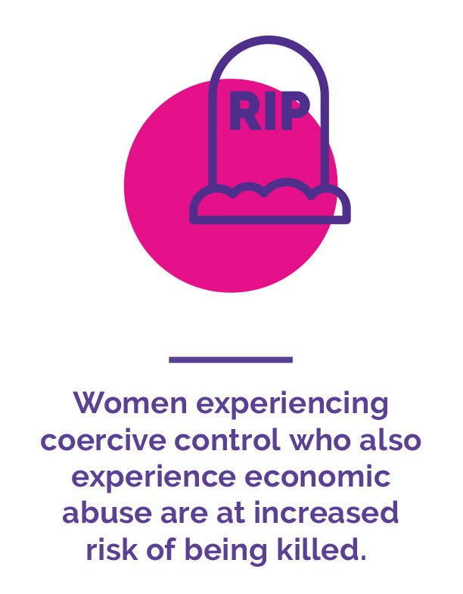
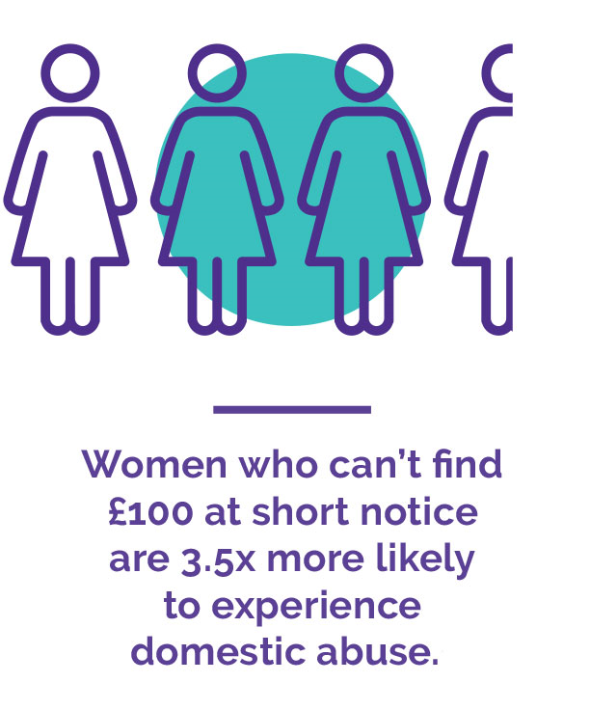
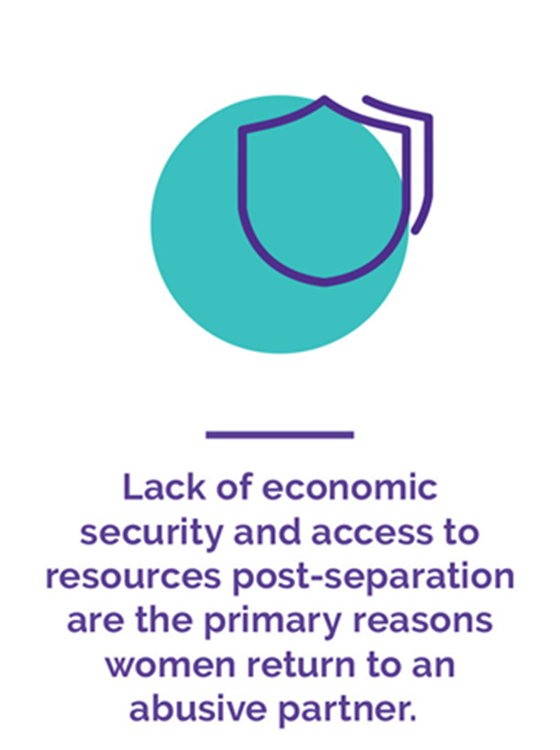
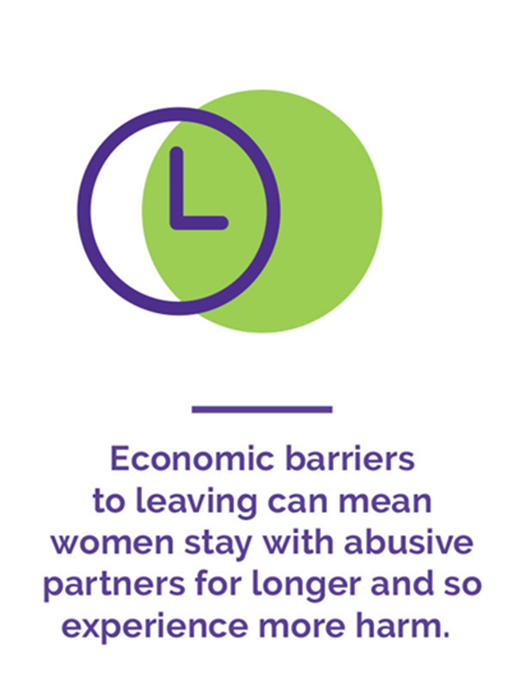
Physical and economic safety are linked

Slide 9
Economic abuse post-separation
Coercive control extends beyond separation
Economic abuse does not require ‘physical proximity’ (Stark, 2007)
Economic abuse may take different forms post-separation (Kelly et al. 2014)
Survivors are simultaneously trying to overcome the economic damage inflicted by the abuser when they were in the relationship, whilst also dealing with new forms of economic abuse post-separation
Notes:
Unrecognised issue – past, present and future.
Mesher orders
Doesn’t require physical proximity, often EA can increase post-separation as only means of control

Slide 10
What can professionals do?
Understand that this form of abuse may persist for many years following separation and often intensifies after a survivor has left the abuser.
Know how to support a survivor to regain economic security and understand how this underpins physical safety.
Access specialist training from organisations such as SEA to aid understanding.
Refer survivors for debt advice, such as the specialist Domestic and Economic Abuse Project (DEAP) run in partnership between SEA and Money Advice Plus.
Try to develop relationships with local debt and money advice services to ensure that they incorporate safety into their work.
Visit SEA’s website for information and resources that survivors can use when liaising with debtors and other agencies.
Support survivors to access legal advice including conveyancing (property law). Can your service make links with local firms for pro bono support?
Prioritise support with locating grants and other resources. (S17)
Arrears cannot be a barrier to moving to safe accommodation.

Slide 11
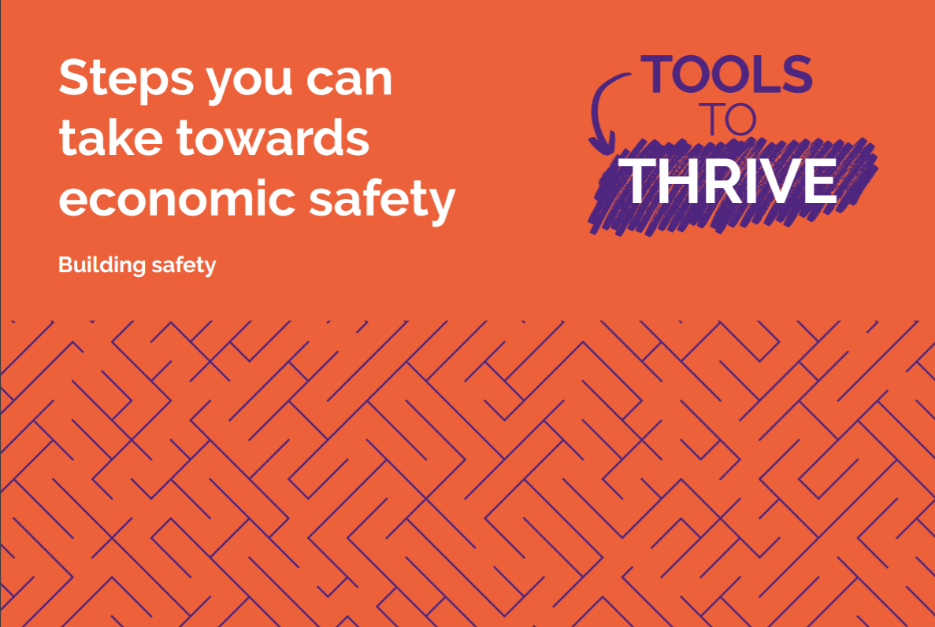
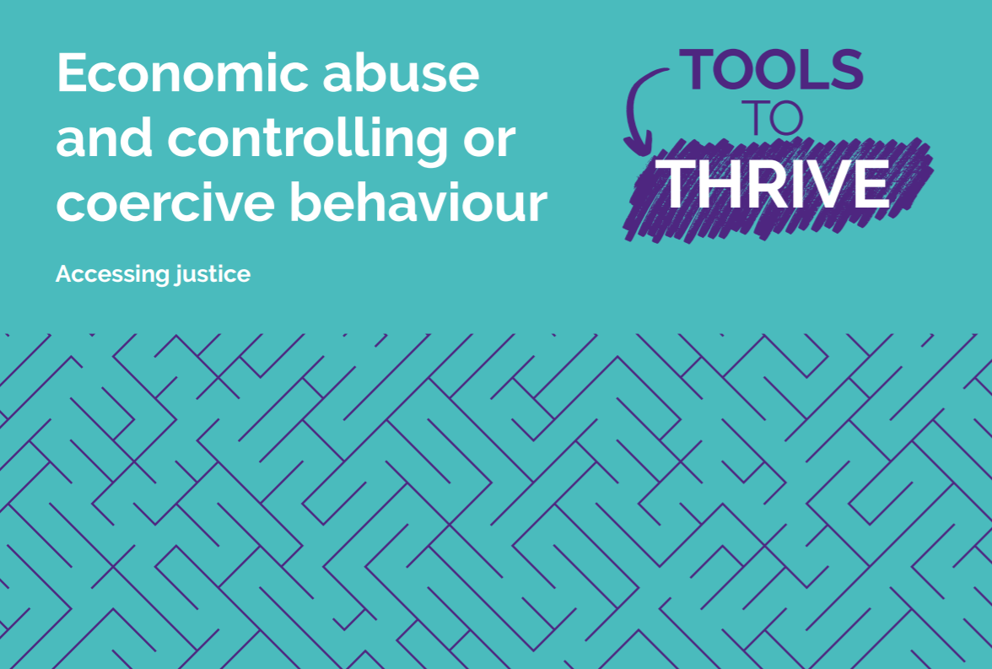
Access resources
I need help - Surviving Economic Abuse

Slide 12
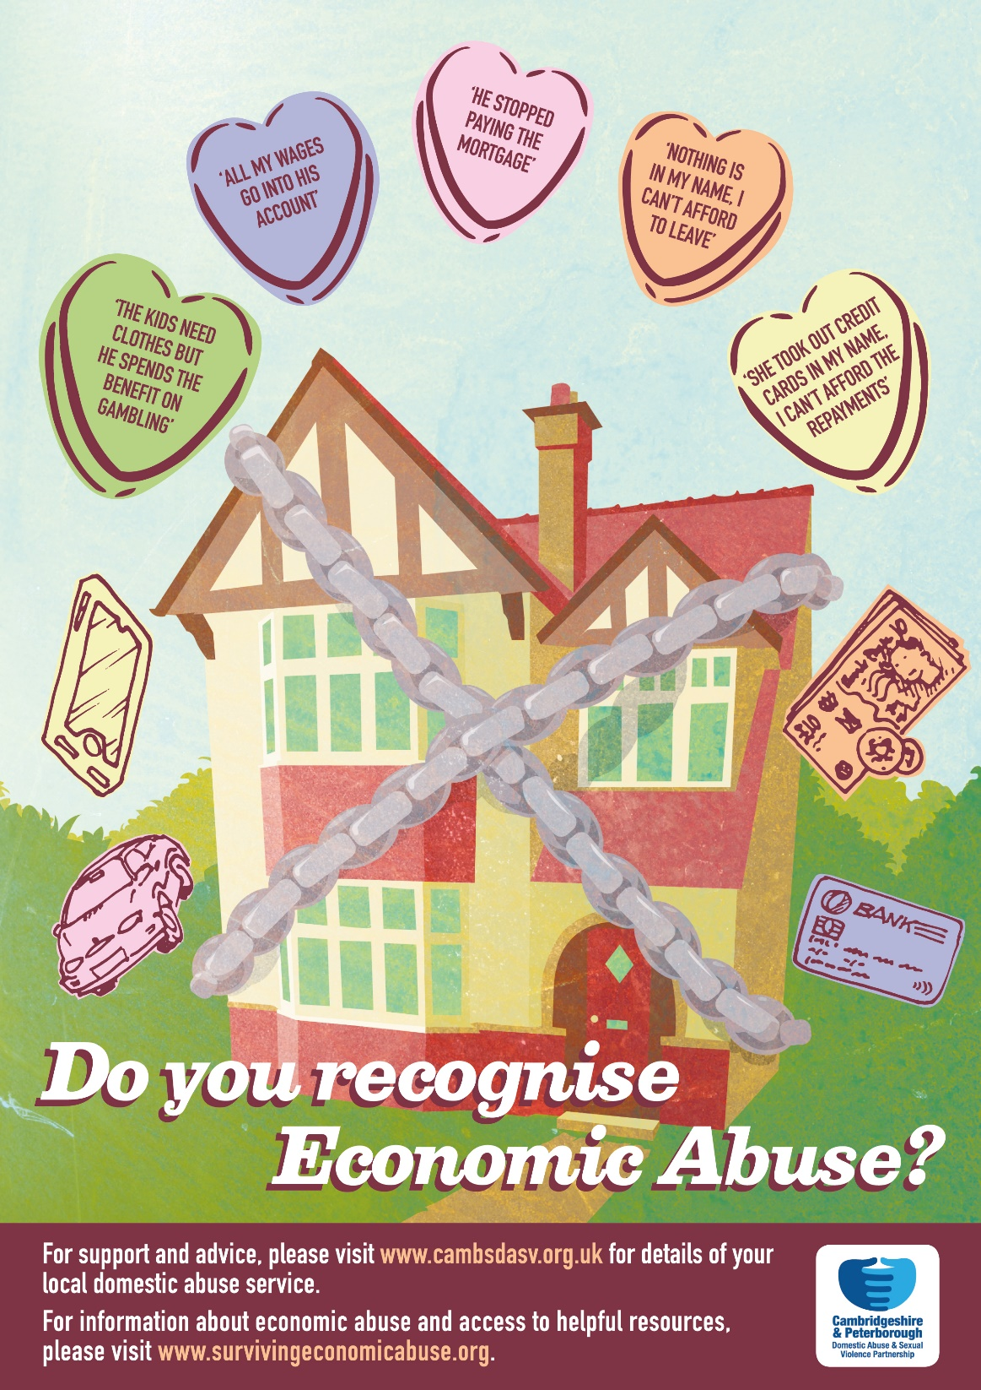

Slide 13

This presentation was produced in partnership with SEA
“Making Money Count ” website - http://makingmoneycount.org.uk/money/

