Slide 1
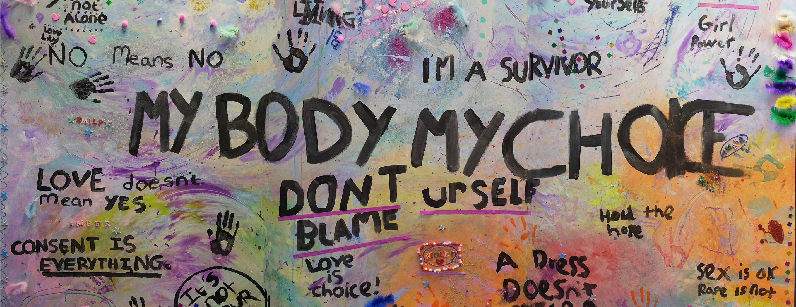
Improving service accessibility and inclusion for the LGBTQ+ community Norah Al-Ani MBE Director

Slide 2
What we will cover
Overview of Cambridge Rape Crisis Centre
EDI work programme at Rape Crisis – focus on LGBTQ+ inclusion
Slow pace of change – LGBTQ+ rights and global context
Prevalence of sexual violence in the LGBTQ+ community
Barriers to accessing support for LGBTQ+ people
Accessibility and inclusion in practice – what we can do
Useful resources
Questions, thoughts, reflections

Slide 3
Cambridge Rape Crisis Centre
Cambridge Rape Crisis Centre (CRCC) is a specialist sexual violence organisation.
CRCC has been delivering specialist support services to survivors in Cambridgeshire for over 40 years.
We aim to support survivors at every stage of their journey to cope and recover, to challenge systemic injustices, and prevent sexual violence through education and awareness raising initiatives.
A professional and passionate team, dedicated to the healing and empowerment of survivors of sexual violence and abuse.

Slide 4
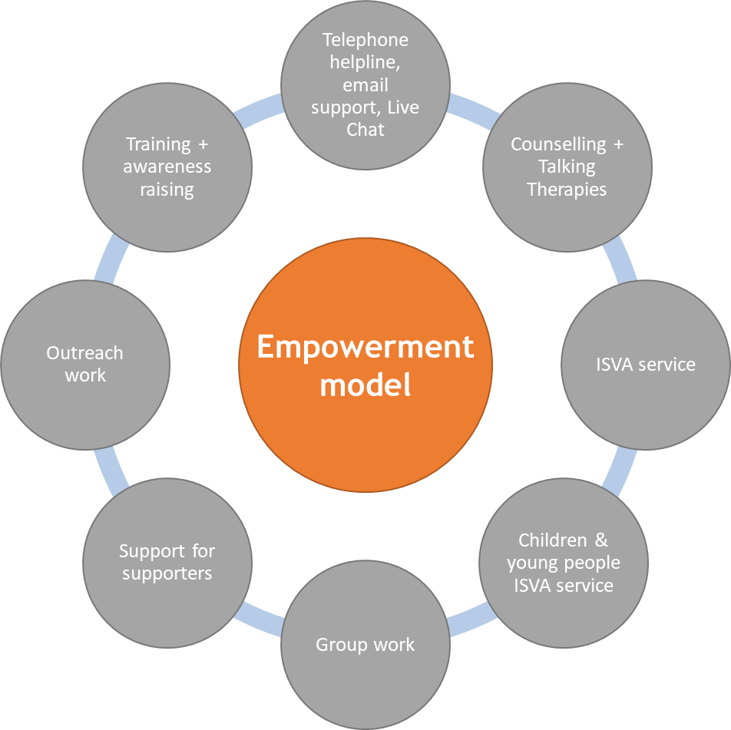
OUR SERVICES

Slide 5
Knowing our community
Statistics collected from the 2021 census has revealed that Cambridge has the biggest population of people who identify as LGBT+ in the East of England.
Cambridge has the 6th highest population of LGBT+ people in the UK.

Slide 6
LGBTQ+ survivors of sexual violence
High proportion of LGBT+ survey respondents reported experiencing sexual harassment (88%) and sexual assault (77%) since the age of 18.
79% of LGBT+ survivors surveyed indicated that they were sexually abused by someone known to them with 17% being sexually abused by a stranger
The vast majority (76%) of LGBT+ survivors surveyed indicated that their most significant experience of sexual violence was perpetrated by a man/men. 54% of the LGBT+ survivors surveyed reported that the orientation of the perpetrator of their most impactful sexual violence experience was heterosexual
82% had told someone about the abuse they had experienced. However, it had taken most of them a long time to do so – only 32% of respondents had spoken about the abuse within six months of the incident taking place. 18% had never told anyone about their most significant experience of sexual violence.
85% experienced negative impacts on their mental health; 77% experienced negative impacts on their intimate relationships; 67% had an increase in suicidal thoughts and 64% increased self-harming.
53% felt that their LGBT+ identity was linked to, or the reason for, at least one instance of sexual violence they were subjected to
Galop Report (Sexual violence - a snapshot of those harming LGBT+ people 2022 + 2023)

Slide 7
Slow pace of change for LGBT+ rights
Sex between men was illegal in England until 1967. Early punishments ranged from fines, imprisonment for up to two years, with or without hard labour and hanging
Having been introduced in the 1980s, Section 28, which prohibited the "promotion of homosexuality" by schools and local authorities, was repealed in 2003
Homosexuality was classified as a ‘mental disorder’ in the Diagnostic and Statistical Manual of Mental Disorders (DSM) beginning with the first edition, published in 1952. It took until 2013 for DSM not to include any diagnostic category that can be applied to people based on their sexual orientation
In 2013 for same sex marriage to be lawful in England and Wales
In the 2016 the ban of LGBT people serving in the Armed Forces was lifted.

Slide 8
Global context
There are 64 countries worldwide (out of a total of 195 countries) that still criminalise homosexuality, despite the global trend generally moving toward more acceptance on LGBT rights
In 2021 Hungary passed a law “banning the portrayal or promotion of homosexuality among under 18’s” Hungary does not recognise same sex marriage, has banned same-sex couples from adopting children and passed a law preventing people from legally changing their gender
Human Rights Watch has also warned that the so-called "LGBT Ideology Free Zones" in almost 100 Polish regions, towns and cities breach the country’s legal obligations under the EU Charter of Fundamental Rights
In 2023, 2% of asylum claims in the UK (1,377 claims) included sexual orientation as part of the basis for the claim

Slide 9
Homophobic and Transphobic hate crime
Hate crime statistics released by the ONS (in 2023) reveal that England and Wales continues to become a less safe place for lesbian, gay, bi and trans people
Hate crimes on the basis of sexual orientation are up by 112% in the last five years
Hate crimes based on sexual orientation and transgender identity are the most likely to involve violence or threats of violence
The Government's own statistics suggest fewer than one in ten LGBTQ+ people report hate crimes or incidents.

Slide 10
Barriers to accessing support
Despite high levels of domestic abuse and sexual violence in the LGBT+ community, it remains acutely underreported and LGBT+ survivors are disproportionally underrepresented in specialist abuse services.
Less than 2% of all domestic abuse survivors accessing IDVA services in England and Wales, identify as LGB and
78% of gay and bisexual men and 80% of gay and bisexual women who have experienced domestic or sexual violence have never reported incidents to the police.
(Galop and Safe Lives 2018)

Slide 11
Barriers to accessing support
LGBT+ survivors often believe that non-LGBT services are ‘not for them’ and fear and/or anticipate being misunderstood or discriminated against by services
LGBT+ survivors might also be reluctant to talk about the abuse or seek help, to protect their abusive partner or family, avoid rejection and denial from their peers and keep their ties with what is often the only support system they know and feel accepted by
LGBT+ people are particularly reluctant to report and engage with the police and are not likely to opt for criminal justice outcomes in the context of domestic abuse
LGBT+ survivors may also fail to recognise and acknowledge their experience as abuse due to myths about DA+SV not taking place in same-sex relationships

Slide 12
Representation and inclusion
Inclusive images on publicity materials
Displaying recognisable symbols of support
Stating clearly in service information that your service is LGBTQ+ inclusive
When describing DA+SV services include and acknowledge the experiences of LGBTQ+ people
Marking and showing support for annual events (such as LGBT History Month, Pride month)
Taking up opportunities for community outreach or targeted publicity
Recognise the importance of Equalities Monitoring data

Slide 13
Improved accessibility
Being aware of, and challenging, heteronormative language and cultures in our organisations/services
Building a better understanding of the barriers faced by LGBTQ+ survivors of DA+SV
Staff training and awareness raising as part of core CPD
Specialist services or specialist community inclusion/engagement workers
Using Equalities Monitoring data meaningfully
Seeking feedback (through staff surveys for example)
Building relationships with specialist LGBTQ+ Support Services, locally and nationally, to improve onward referral pathways
Ensuring any delivery of healthy relationships work with young people includes LGBTQ+ relationships

Slide 14
Sustaining change
Leadership support and accountability (from our trustee board for example)
Accessibility Working Group – membership made up of staff, volunteers and trustees
EDI as a standing agenda item at weekly team meetings and monthly trustee meetings
Adherence to the Rape Crisis National Service Standards – which includes core standards on accessibility of our services for minoritized or under represented communities
Robust EDI Policies (we have a Trans Inclusive policy, Support for Neurodiverse Survivors, Anti-Racism Action Plan for example)

Slide 15
Useful Resources
The Kite Trust https://thekitetrust.org.uk/
Galop https://galop.org.uk/resources-publications/
Self Help Guide for Transgender Survivors of Sexual Violence (Transgender Sexual Violence Project) https://forge-forward.org/wp-content/uploads/2020/08/self-help-guide-to-healing-2015-FINAL.pdf
Guide for Lesbian and Bisexual Women Affected by Sexual Violence (Survivors Network) https://survivorsnetwork.org.uk/resource/guide-for-lesbian-and-bisexual-women-affected-by-sexual-violence/
Cambridgeshire + Peterborough DASV Partnership https://www.cambsdasv.org.uk/web/lgbtq/138995

Slide 16
Any questions? Get in touch...
01223 313 551
norah@cambridgeraperisis.org.uk
cambridgerapecrisis.org.uk
© please do not reproduce without permission from CRCC

